Slide 1
Task 2
Finding vulnerabilities in http://testasp.vulnweb.com/

Slide 2
Vulnerabilities:
The first vulnerability I found was that the password was getting transmitted over http.
The second vulnerability I found was Cross site scripting

Slide 3
1. Website using HTTP
This vulnerability can be misused if the network is intercepted
User credentials can be easily stolen from this method
This was the vulnerability I found in http://testasp.vulnweb.com/login.asp
Since HTTP doesn’t encrypt the lines of text in request and response forms, this can be easily intercepted.

Slide 4
Steps to reproduce:
Open Burpsuite
Open browser in the burp
Open the website http://testasp.vulnweb.com/login.asp
Turn on the intercept in burpsuite
Provide previously registered username and password
Click login button
You can see the POST form with username and password unencrypted.

Slide 5
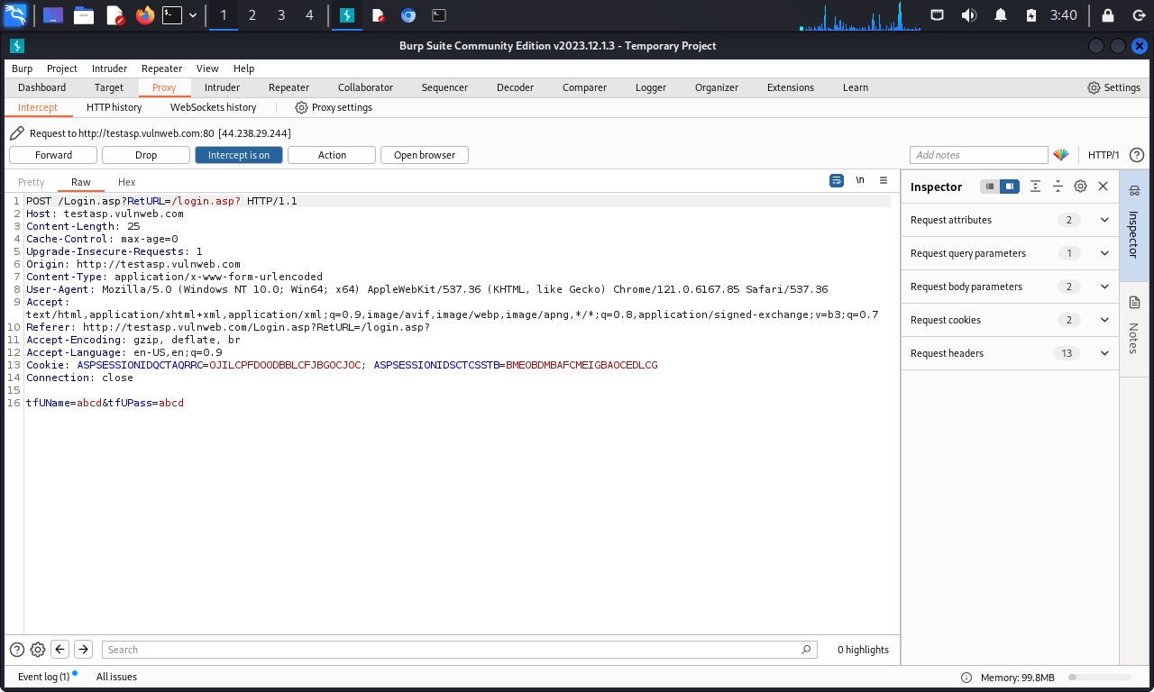

Slide 6
Remedy:
Making all the forms follow HTTPS protocol instead on HTTP
Implement SSL/TLS

Slide 7
2. Cross site scripting
This vulnerability can be used to change the face of website and trigger alert responses etc
Can be used to launch phishing attacks
This was the vulnerability I found in http://testasp.vulnweb.com/Search.asp

Slide 8
Steps to reproduce:
1.First opened website http://testasp.vulnweb.com.
2. In the search tab typed random text and intercepted on burpsuite
3. Sent it to the intruder.
4. Selected the typed text and entered the payload that I got from common XSS payloads from a website.
5. Started the attack with the pasted payload.
6. Checked for random payload and found that few payload was triggering alert response

Slide 9
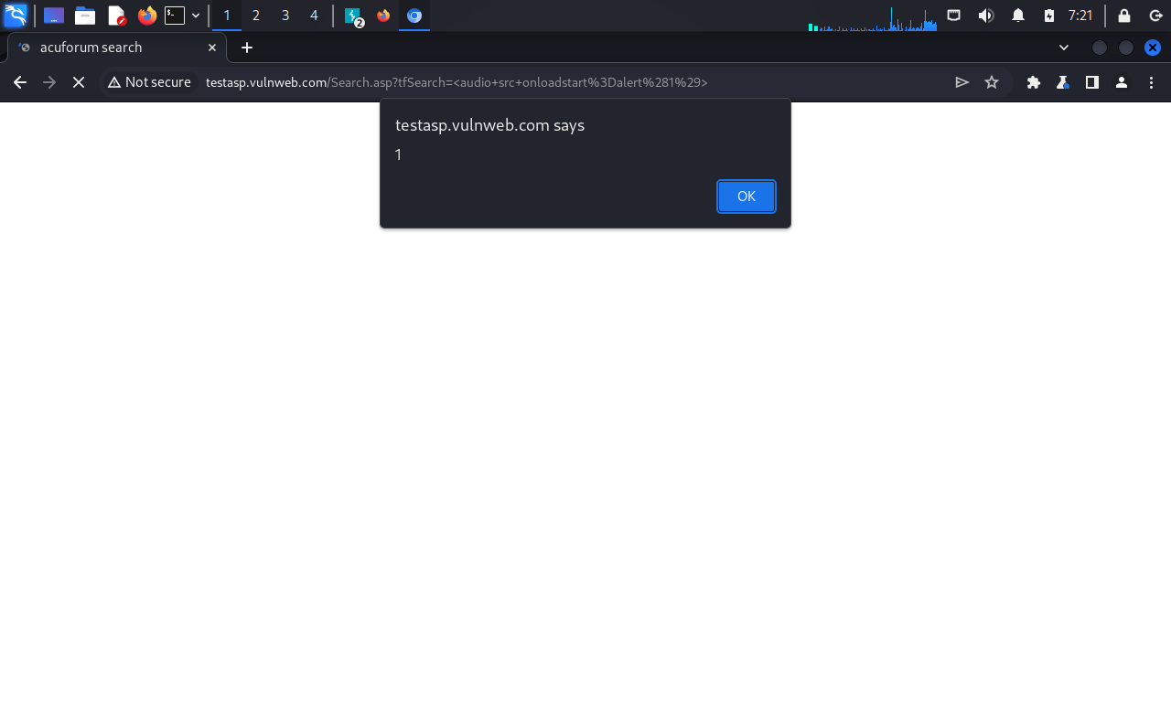
Payloads examples when typed directly into the search box and their responses
1. <audio src onloadstart=alert(1)>

Slide 10
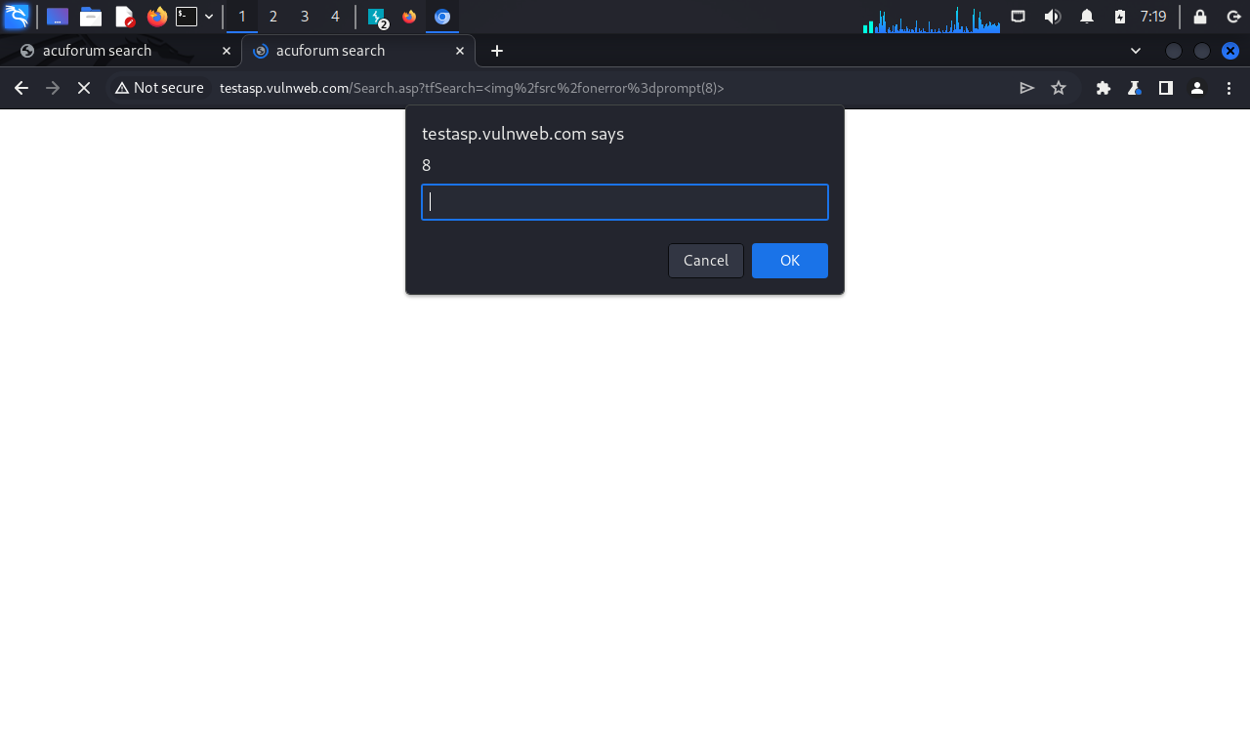
Payloads examples when typed directly into the search box and their responses
2. <img/src/onerror=prompt(8)>

Slide 11
Remedy:
Input and output from website should be filtered.
Encode data on output.
Implement content security policy as defense in depth measure.

Slide 12
THANK YOU

